Slide 2
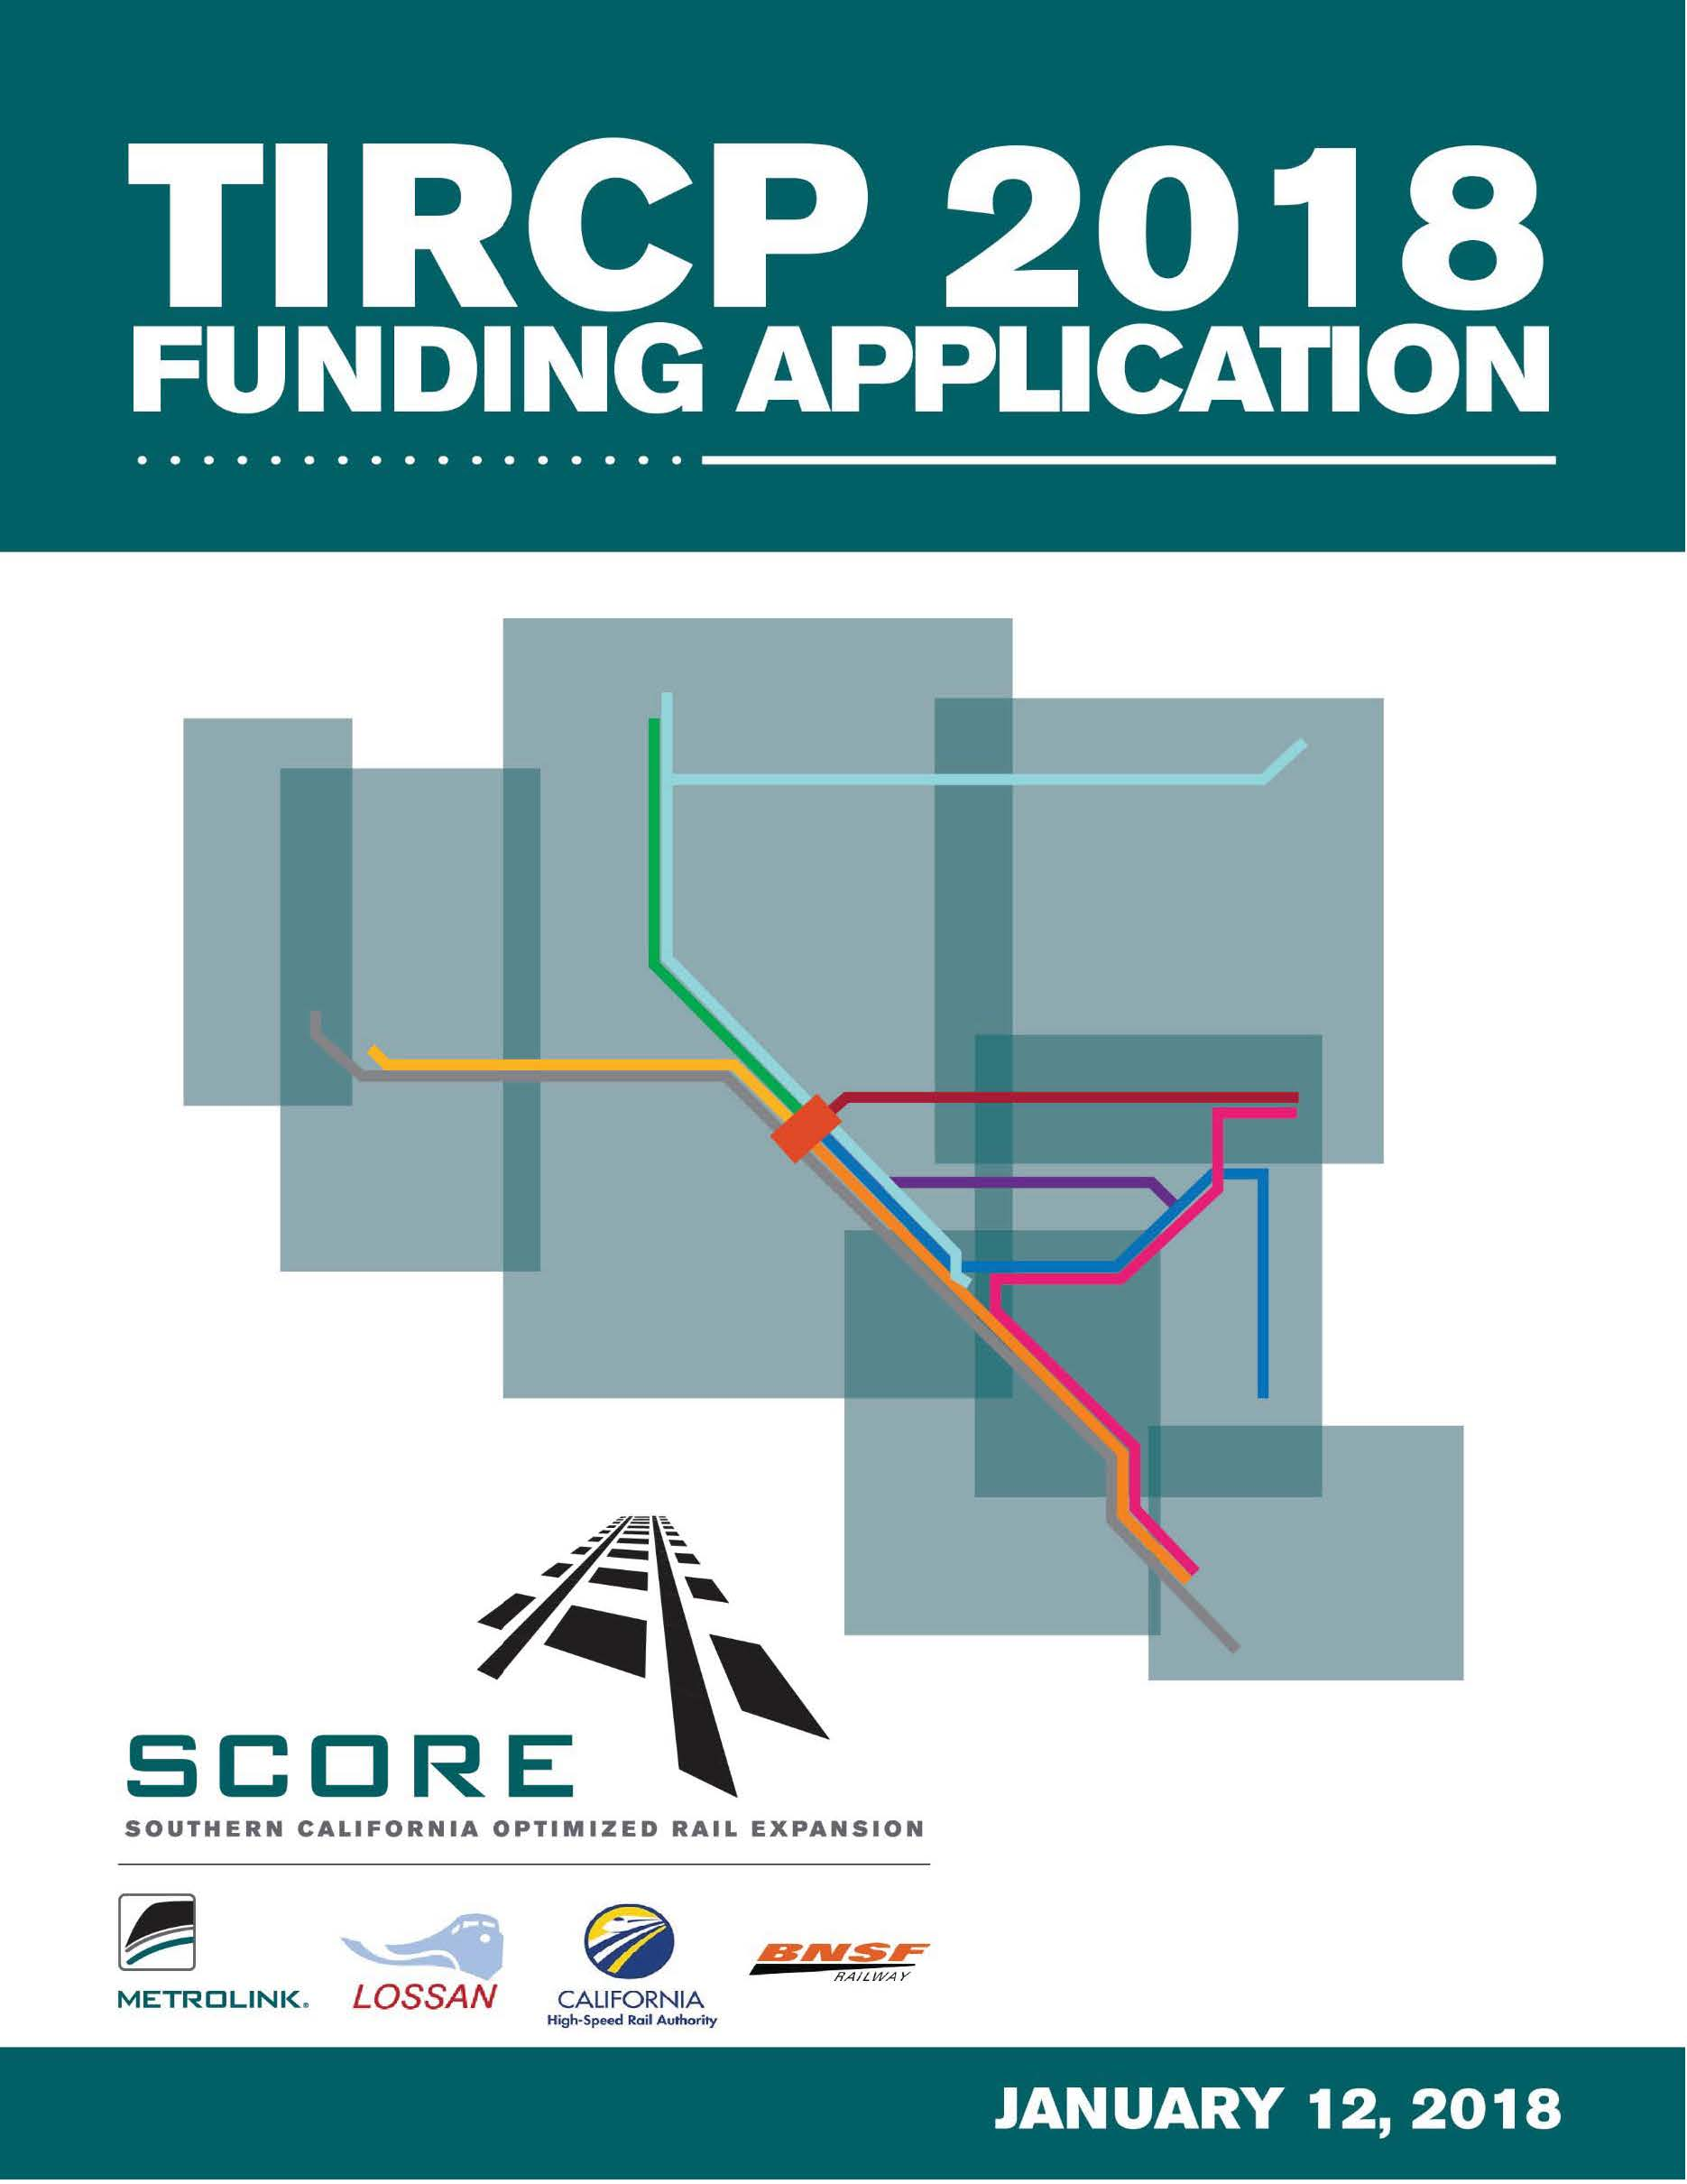
Metrolink Transit and Intercity Rail Capital Program (TIRCP) Application - SCORE
METROLINK ADWHEEL AWARDS | 2018
2

Slide 3
Educational material:
SCORE service frequency map
Result:
Provided awareness of regional benefits
METROLINK ADWHEEL AWARDS | 2018
3

Slide 4
Infographic – SCORE Program
Infographic is part of
awareness
campaign to inform and educate
METROLINK ADWHEEL AWARDS | 2018
4

Slide 5
Infographic – SCORE Program
Result:
Campaign
focused on
clear vision and benefits
METROLINK ADWHEEL AWARDS | 2018
5

Slide 6
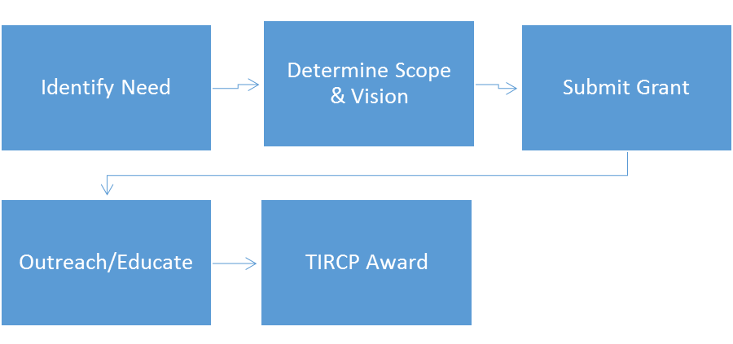
Grant Submission - Process
After identifying the need,
Metrolink determined the
scope of the TIRCP
application and larger
vision of SCORE
METROLINK ADWHEEL AWARDS | 2018
6

Slide 7
Target Audience
Elected Officials
Agencies
Funding Partners
Stakeholders
Senators
State Senators
California Air Resources Board (CARB)
South Coast Air Quality Management District (AQMD)
Senate Transportation Committee
Assembly Transportation Committee
Caltrans
California State Transportation Agency (CalSTA)
California Transportation Commission (CTC)
Contractors
Trade Organizations
Chamber of Commerce
Community Based Organizations
Advocacy Organization
Members of Congress
State Assemblymembers
City Councilmembers
Nonprofits
METROLINK ADWHEEL AWARDS | 2018
7

Slide 8
Media Outreach – Press Releases
Results:
Improved awareness of benefits and continued engagement with
stakeholders
METROLINK ADWHEEL AWARDS | 2018
8

Slide 9
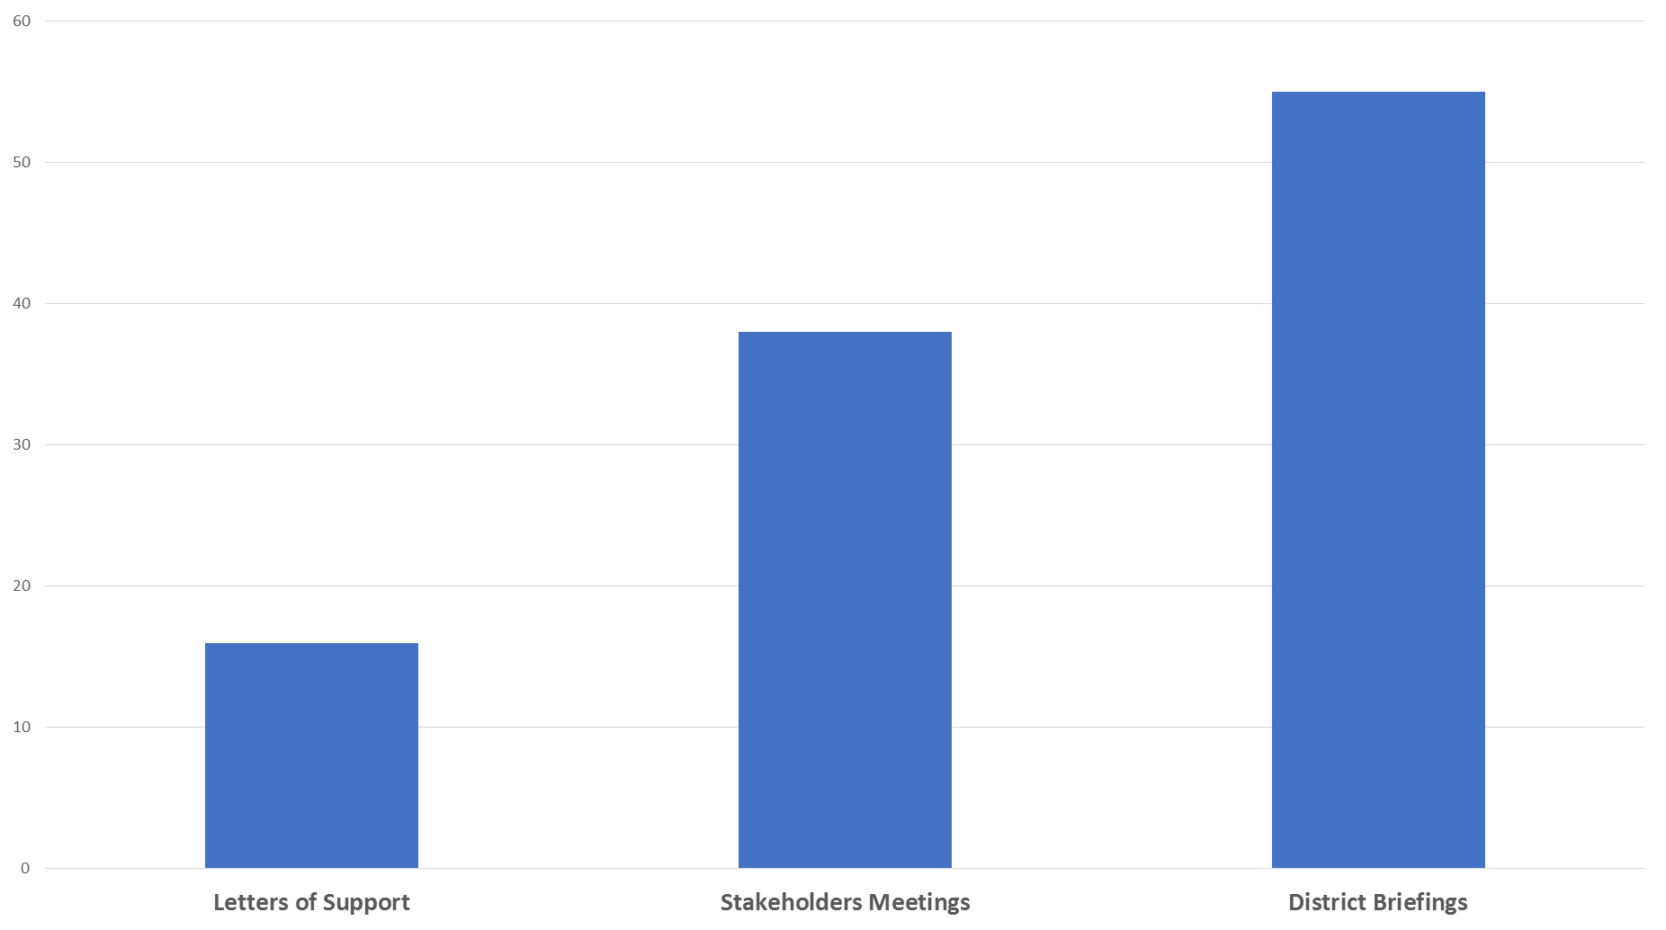
Outreach – Broad Support
Result:
16 support letters
38 stakeholder meetings
55 district briefings
METROLINK ADWHEEL AWARDS | 2018
9

